Slide 1

Real-Time Student Engagement Monitoring Dashboard
Giving faculty instant visibility into student activity during lab sessions — so no one falls through the cracks.
EDUCATIONAL TECHNOLOGY
LAB MANAGEMENT

Slide 2

The Problem: Faculty Are Flying Blind
During lab sessions, instructors cannot continuously monitor which students are actively working, who is idle, and who is off-task. Manual monitoring is inefficient, inaccurate, and not scalable for large labs.
Inefficient
Faculty can't physically observe every student simultaneously in a large lab.
Inaccurate
Visual checks miss subtle off-task behavior like browsing or messaging.
Not Scalable
As lab sizes grow, manual oversight becomes practically impossible.

Slide 3
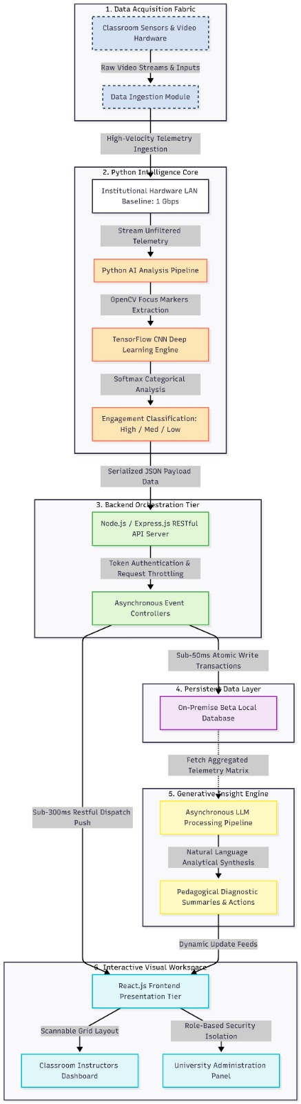
Work Flow
Data Collection - Collecting student activity data from attendance, LMS, and interactions.
Data Processing - Cleaning, normalizing, and preparing raw data for analysis.
Engagement Classification - Categorizing students into high, medium, or low engagement based on scores.
Data Storage - Categorizing students into high, medium, or low engagement based on scores.
Dashboard Visualization - Displaying insights, trends, and engagement reports using charts and graphs.

Slide 4

What Faculty Can't See — But Should
Without a real-time monitoring system, critical engagement gaps go undetected:
Who is actively working?
No visibility into which students are genuinely focused on their lab tasks.
Who is idle?
Students who have stopped working may go unnoticed for extended periods.
Who is off-task?
Distractions like social media or unrelated browsing remain invisible to faculty.

Slide 5
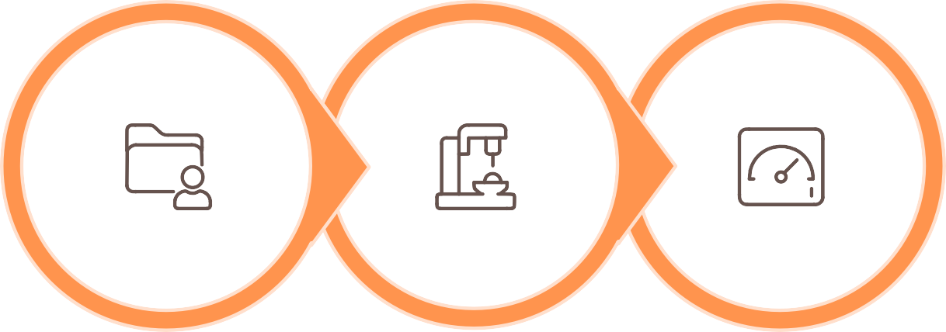
The Solution: A Live Engagement Dashboard
A real-time system that continuously collects student activity data, classifies engagement states, and displays them on a live dashboard — giving faculty instant, actionable visibility.
Classify State
Show Dashboard
Collect Data
The system operates automatically in the background, requiring no manual input from faculty or students during lab sessions.

Slide 6
Visual Status Indicators at a Glance
Faculty see the entire lab's engagement status instantly through a simple, intuitive color-coded system.
🟢 Green — Active
Student is actively working and engaged with lab tasks.
🟡 Yellow — Idle
Student has been inactive for a defined threshold period.
🔴 Red — Off-Task
Student activity indicates distraction or non-lab-related behavior.

Slide 7







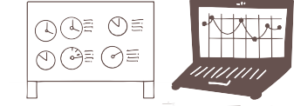




Core Features
Real-Time Activity Tracking
Continuously monitors student system activity with no delay, ensuring faculty always see the current state of the lab.
Student Status Classification
Automatically categorizes each student as Active, Idle, or Off-Task based on behavioral signals.
Live Color-Coded Dashboard
A single-pane view showing all students' engagement levels with intuitive green, yellow, and red indicators.

Slide 8
Smart & Advanced Capabilities
Smart Features
Auto-Refresh Dashboard
Updates automatically — no manual refresh needed.
Student Activity Summary
Per-student breakdown of engagement over the session.
Advanced Features
Class-Level Analytics
Percentage of active students across the entire lab.
Historical Trends
Track engagement patterns across sessions and semesters.
Role-Based Access
Separate views for faculty oversight and student self-awareness.
Behavioral Alerts
Notifies faculty when a student is idle or off-task beyond a threshold.

Slide 9

Who Benefits — and How
For Faculty
Instantly identify disengaged students, manage large labs efficiently, and take immediate corrective action — all from one dashboard.
For Institutions
Improve lab productivity, monitor engagement patterns over time, and support data-driven academic decisions at the program level.
For Students
When visible to students, the dashboard encourages self-regulation and focus by making engagement status transparent.

Slide 10

Known Challenges & Considerations
Accurate engagement detection requires careful design to avoid false readings.
"Browser Open" ≠ Working
A browser window doesn't confirm productive activity — students may browse unrelated content.
"VS Code Open" ≠ Coding
An open IDE doesn't mean active coding — the student could be idle or distracted.
Idle Detection Can Mislead
Thinking or reading may register as idle — thresholds must account for legitimate pauses.

Slide 11
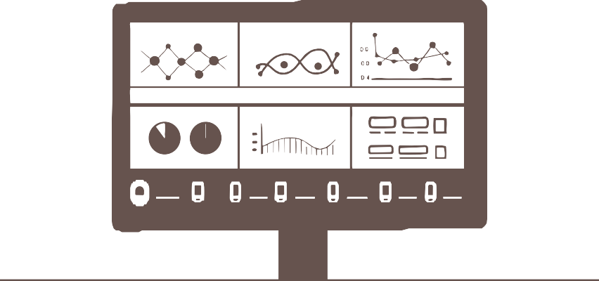
Key Takeaways
Real-time visibility replaces guesswork
Faculty gain instant, accurate insight into every student's engagement state during lab sessions.
Color-coded status enables fast action
Green, yellow, and red indicators let instructors prioritize attention where it's needed most.
Scalable, data-driven lab management
From individual alerts to class-level analytics, the system supports better decisions at every level.

